Slide 1
C++ Programming: From Problem Analysis to Program Design, Fourth Edition
Chapter 12: Classes and Data Abstraction

Slide 2
Objectives
In this chapter, you will:
Learn about classes
Learn about private, protected, and public members of a class
Explore how classes are implemented
Examine constructors and destructors
Learn about the abstract data type (ADT)
C++ Programming: From Problem Analysis to Program Design, Fourth Edition
‹#›

Slide 3
Objectives (continued)
Explore how classes are used to implement ADTs
Learn about information hiding
Explore how information hiding is implemented in C++
Learn about the static members of a class
C++ Programming: From Problem Analysis to Program Design, Fourth Edition
‹#›

Slide 4
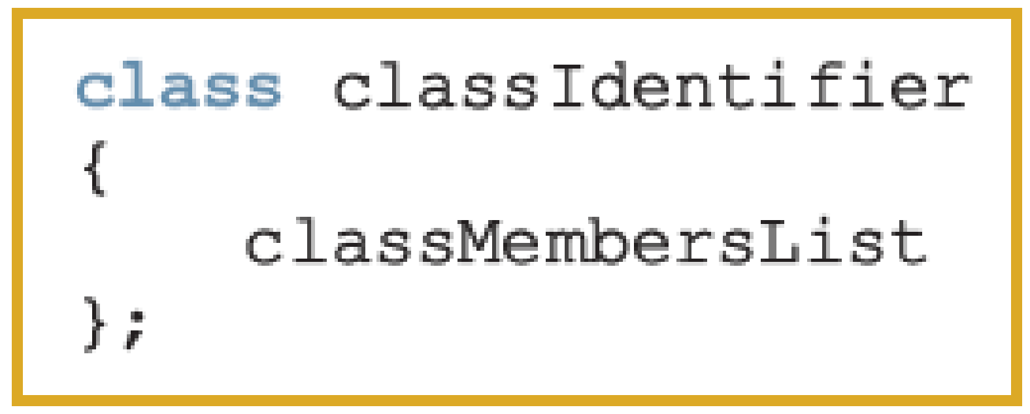
Classes
Class: collection of a fixed number of components (members)
Definition syntax:
Defines a data type; no memory is allocated
Don’t forget the semicolon after closing brace
C++ Programming: From Problem Analysis to Program Design, Fourth Edition
‹#›

Slide 5
Classes (continued)
Class member can be a variable or a function
If a member of a class is a variable
It is declared like any other variable
In the definition of the class
You cannot initialize a variable when you declare it
If a member of a class is a function
Function prototype is listed
Function members can (directly) access any member of the class
C++ Programming: From Problem Analysis to Program Design, Fourth Edition
‹#›

Slide 6
Classes (continued)
Three categories of class members
private (default)
Member cannot be accessed outside the class
Public
Member is accessible outside the class
Protected //will be discussed later
class A {
int x;
void fun();
};
Any member (variable or function) can be public or private or protected
C++ Programming: From Problem Analysis to Program Design, Fourth Edition
‹#›

Slide 7
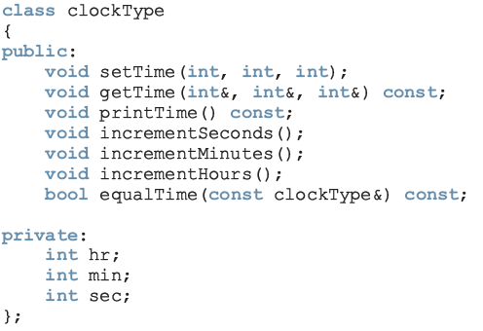
Classes (continued)
These functions cannot modify the member variables of a variable of type clockType
const: formal parameter can’t modify
the value of the actual parameter
private members,
can’t be accessed from outside the class
C++ Programming: From Problem Analysis to Program Design, Fourth Edition
‹#›

Slide 8
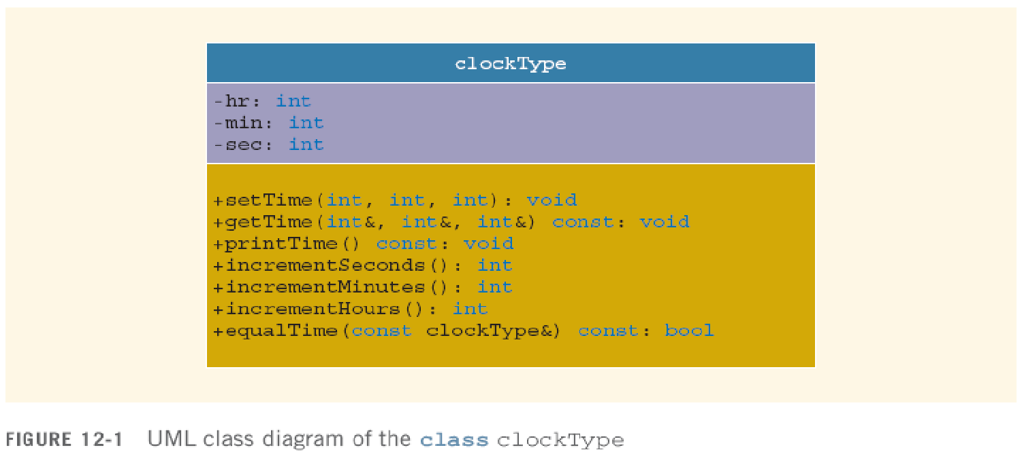
Unified Modeling Language Class Diagrams
To describe the class graphically
+: member is public
-: member is private
#: member is protected
C++ Programming: From Problem Analysis to Program Design, Fourth Edition
‹#›

Slide 9
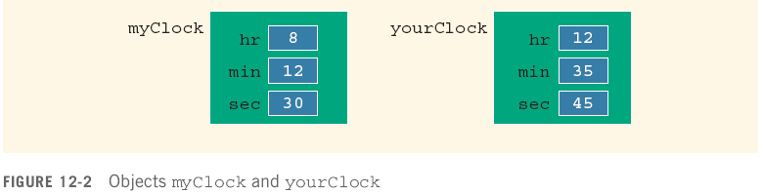
Variable (Object) Declaration
Once a class is defined, you can declare variables of that type
clockType myClock;
clockType yourClock;
A class variable is called a class object or class instance
OOP stands for Object Oriented Programming: encapsulates data and functions into packages called classes.
C++ Programming: From Problem Analysis to Program Design, Fourth Edition
‹#›

Slide 10

Accessing Class Members
Once an object is declared, it can access the public members of the class
Syntax:
The dot (.) is the member access operator
If object is declared in the definition of a member function of the class, it can access the public and private members
C++ Programming: From Problem Analysis to Program Design, Fourth Edition
‹#›

Slide 11
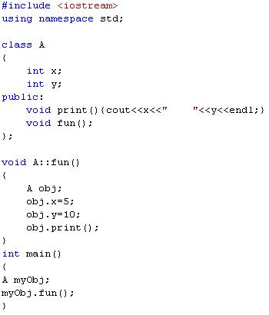
5 10

Slide 12
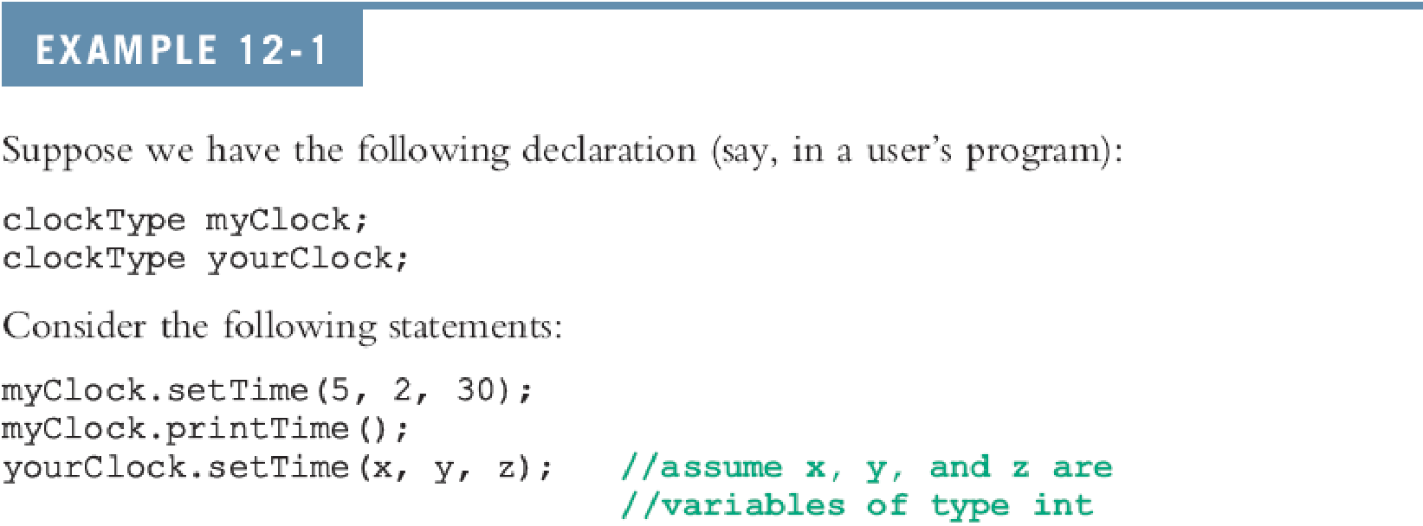
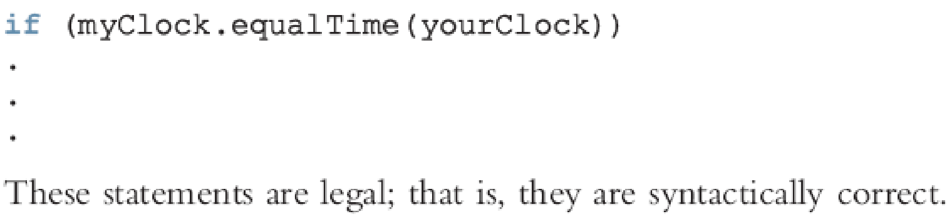
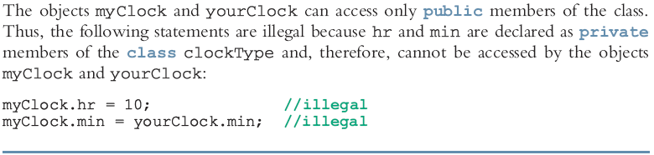

Slide 13
Built-in Operations on Classes
Most of C++’s built-in operations do not apply to classes
Arithmetic operators cannot be used on class objects unless the operators are overloaded //ch 15
You cannot use relational operators to compare two class objects for equality
Built-in operations valid for class objects:
Member access (.)
Assignment (=)
C++ Programming: From Problem Analysis to Program Design, Fourth Edition
‹#›

Slide 14
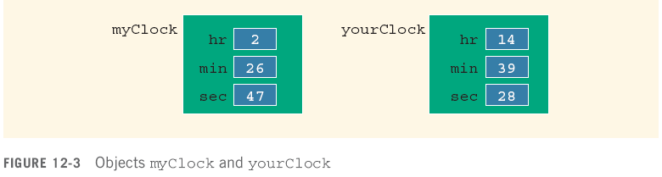
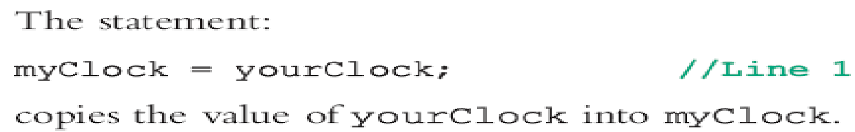
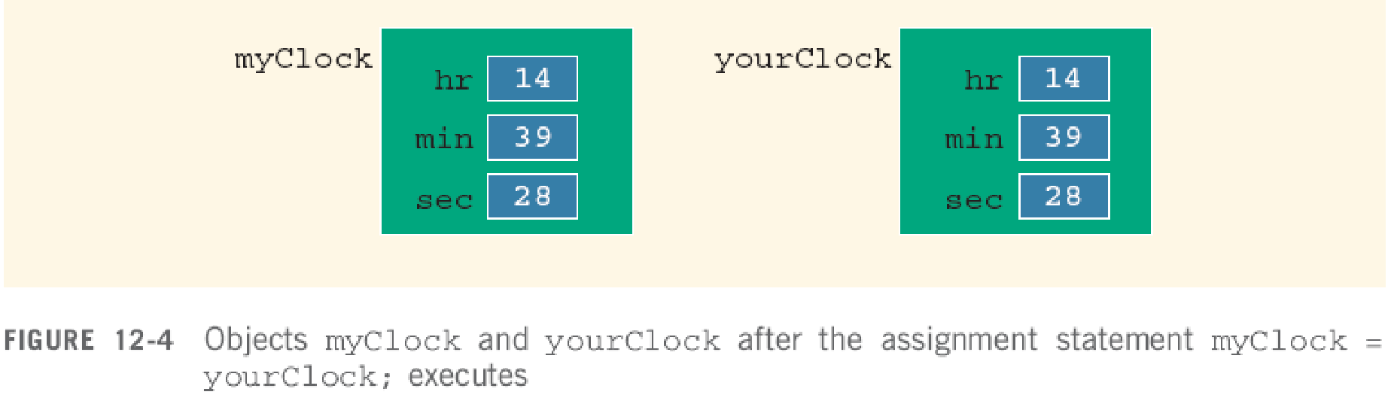
Assignment Operator and Classes
C++ Programming: From Problem Analysis to Program Design, Fourth Edition
‹#›

Slide 15
Class Scope
An object can be automatic or static
A member of the class is local to the class
You access a class member outside the class by using the class object name and the member access operator (.)
C++ Programming: From Problem Analysis to Program Design, Fourth Edition
‹#›

Slide 16
Functions and Classes
Objects can be passed as parameters to functions and returned as function values
As parameters to functions
Objects can be passed by value or by reference
If an object is passed by value
Contents of data members of the actual parameter are copied into the corresponding data members of the formal parameter
C++ Programming: From Problem Analysis to Program Design, Fourth Edition
‹#›

Slide 17
Reference Parameters and Class Objects (Variables)
Passing by value might require a large amount of storage space and a considerable amount of computer time to copy the value of the actual parameter into the formal parameter
If a variable is passed by reference
The formal parameter receives only the address of the actual parameter
C++ Programming: From Problem Analysis to Program Design, Fourth Edition
‹#›

Slide 18
Reference Parameters and Class Objects (Variables) (continued)
Pass by reference is an efficient way to pass a variable as a parameter
Problem: when passing by reference, the actual parameter changes when formal parameter changes
Solution: use const in the formal parameter declaration
C++ Programming: From Problem Analysis to Program Design, Fourth Edition
‹#›

Slide 19
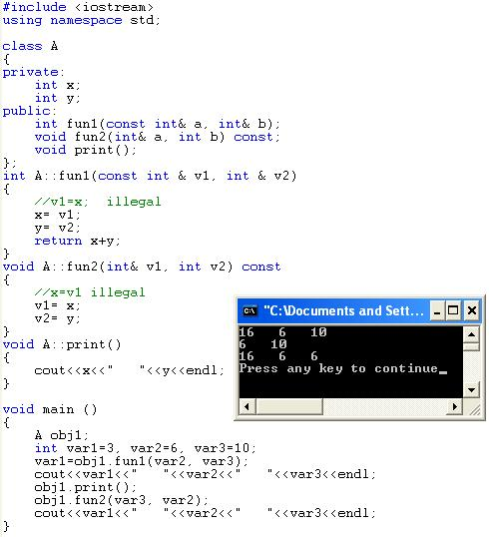
Example:

Slide 20
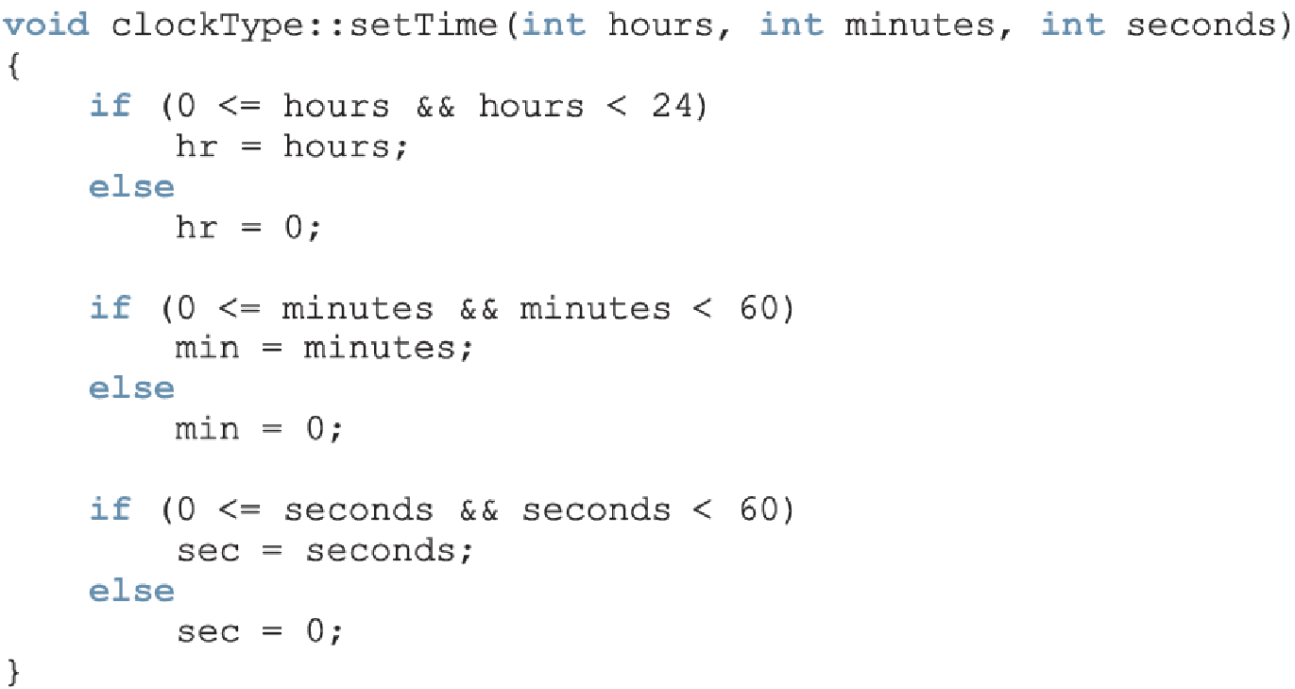
Implementation of Member Functions
Scope resolution operator
C++ Programming: From Problem Analysis to Program Design, Fourth Edition
‹#›

Slide 21


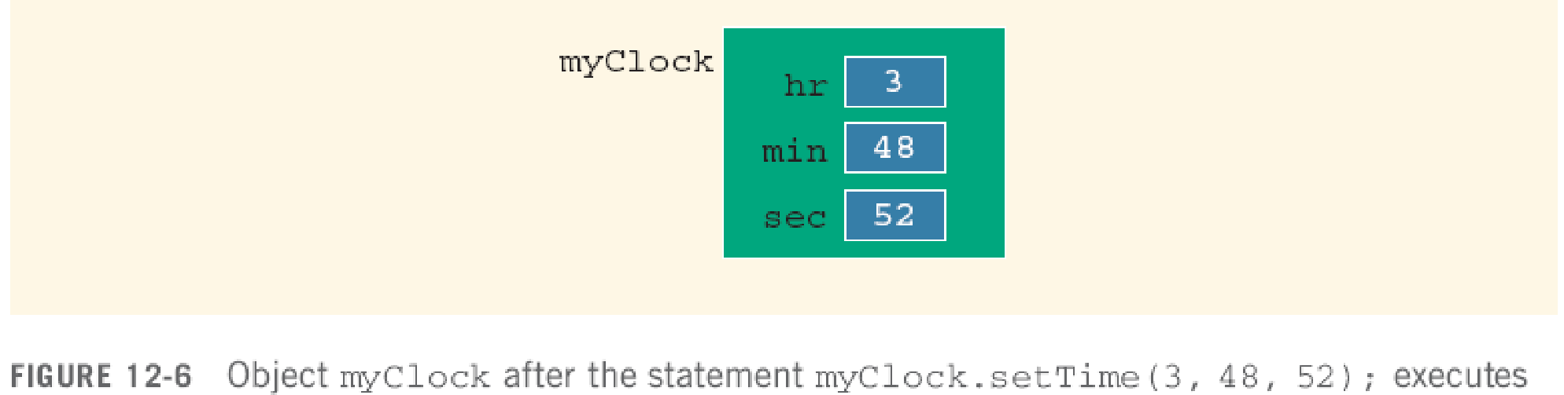
Implementation of Member Functions (continued)
C++ Programming: From Problem Analysis to Program Design, Fourth Edition
‹#›

Slide 22
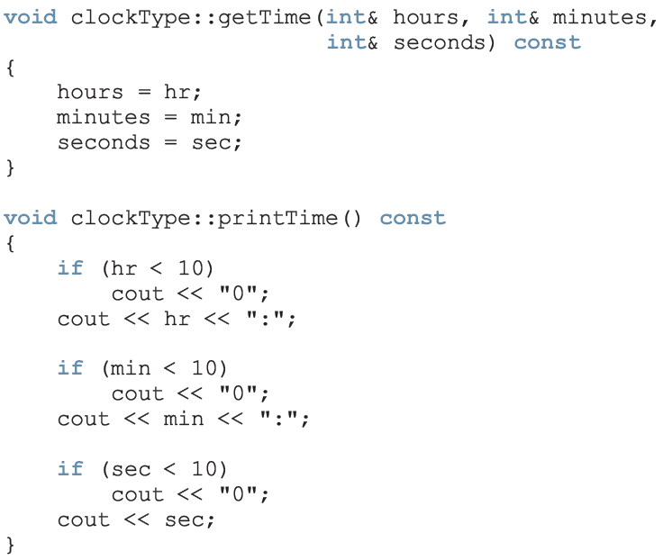

Slide 23
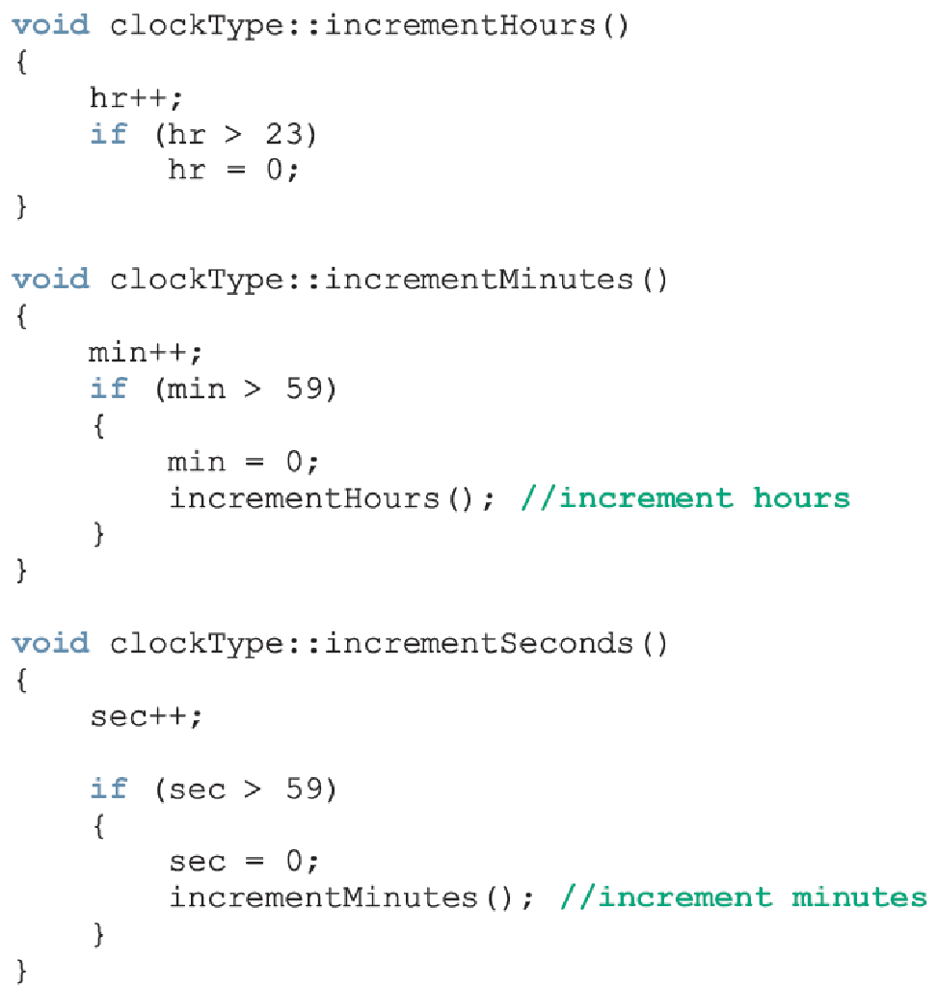
if hr= 23 then hr= 0
if hr= 23 min=59 then
min =0 hr++
hr=0 min=0
if hr= 23 min= 59 sec = 59 then by sec++
sec=0 min++
min=0 hr++
hr= 0 min=0 sec=0

Slide 24
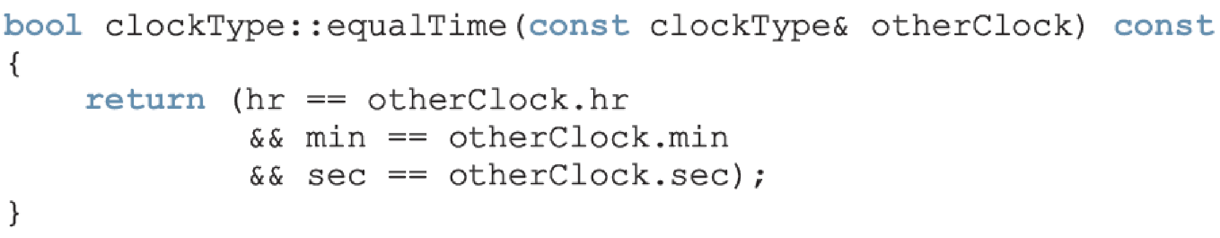

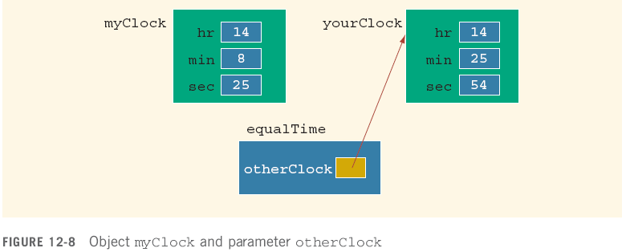

Slide 25
Implementation of Member Functions (continued)
Once a class is properly defined and implemented, it can be used in a program
A program that uses/manipulates the objects of a class is called a client of that class
When you declare objects of the class clockType, every object has its own copy of the member variables (hr, min, and sec)
Variables such as hr, min, and sec are called instance variables of the class
Every object has its own instance of the data
C++ Programming: From Problem Analysis to Program Design, Fourth Edition
‹#›

Slide 26
Accessor and Mutator Functions
Accessor function: member function that only accesses the value(s) of member variable(s)
Mutator function: member function that modifies the value(s) of member variable(s)
Constant function:
Member function that cannot modify member variables
Use const in function heading
C++ Programming: From Problem Analysis to Program Design, Fourth Edition
‹#›

Slide 27
Order of public and private Members of a Class
C++ has no fixed order in which you declare public and private members
By default, all members of a class are private
Use the member access specifier public to make a member available for public access
C++ Programming: From Problem Analysis to Program Design, Fourth Edition
‹#›

Slide 28
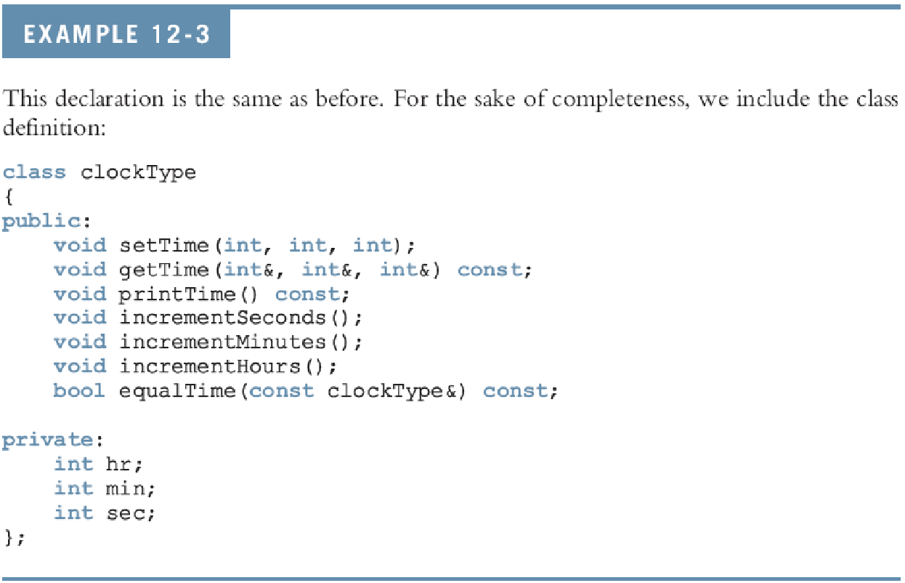
Order of public and private Members of a Class (continued)
C++ Programming: From Problem Analysis to Program Design, Fourth Edition
‹#›

Slide 29
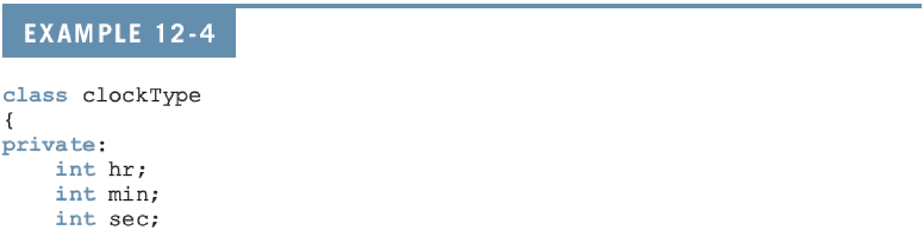
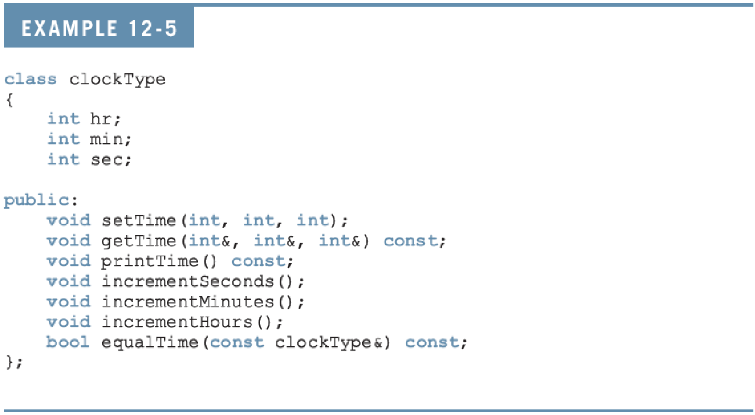
Order of public and private Members of a Class (continued)
C++ Programming: From Problem Analysis to Program Design, Fourth Edition
‹#›

Slide 30
Order of public and private Members of a Class (continued)
C++ Programming: From Problem Analysis to Program Design, Fourth Edition
‹#›

Slide 31
Constructors
Use constructors to guarantee that data members of a class are initialized
Two types of constructors:
With parameters
Without parameters (default constructor)
The name of a constructor is the same as the name of the class
A constructor has no type
C++ Programming: From Problem Analysis to Program Design, Fourth Edition
‹#›

Slide 32
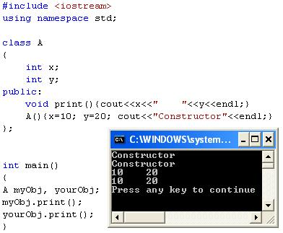

Slide 33
Constructors (continued)
A class can have more than one constructor
Each must have a different formal parameter list
Constructors execute automatically when a class object enters its scope
They cannot be called like other functions
Which constructor executes depends on the types of values passed to the class object when the class object is declared
C++ Programming: From Problem Analysis to Program Design, Fourth Edition
‹#›

Slide 34
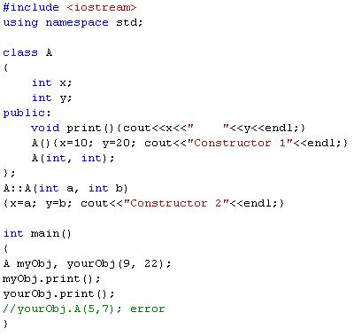
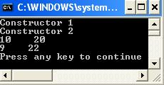

Slide 35
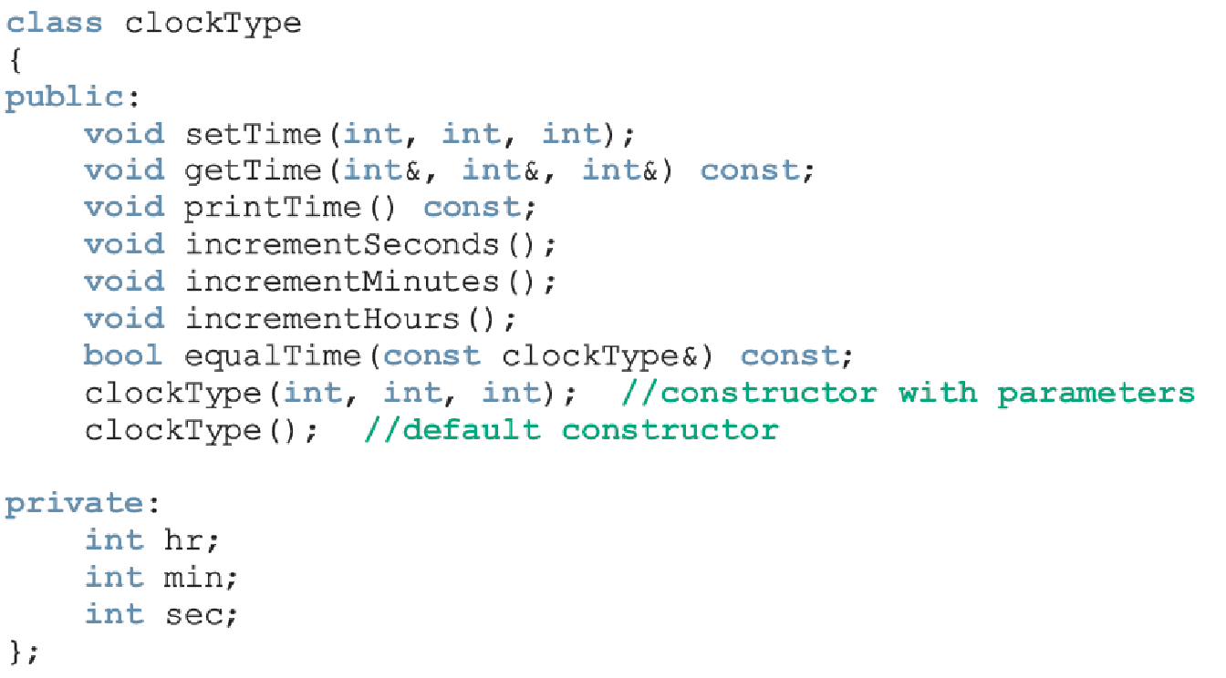
Constructors (continued)
C++ Programming: From Problem Analysis to Program Design, Fourth Edition
‹#›

Slide 36
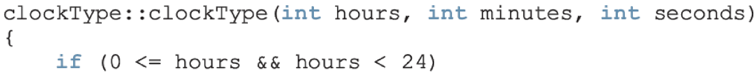
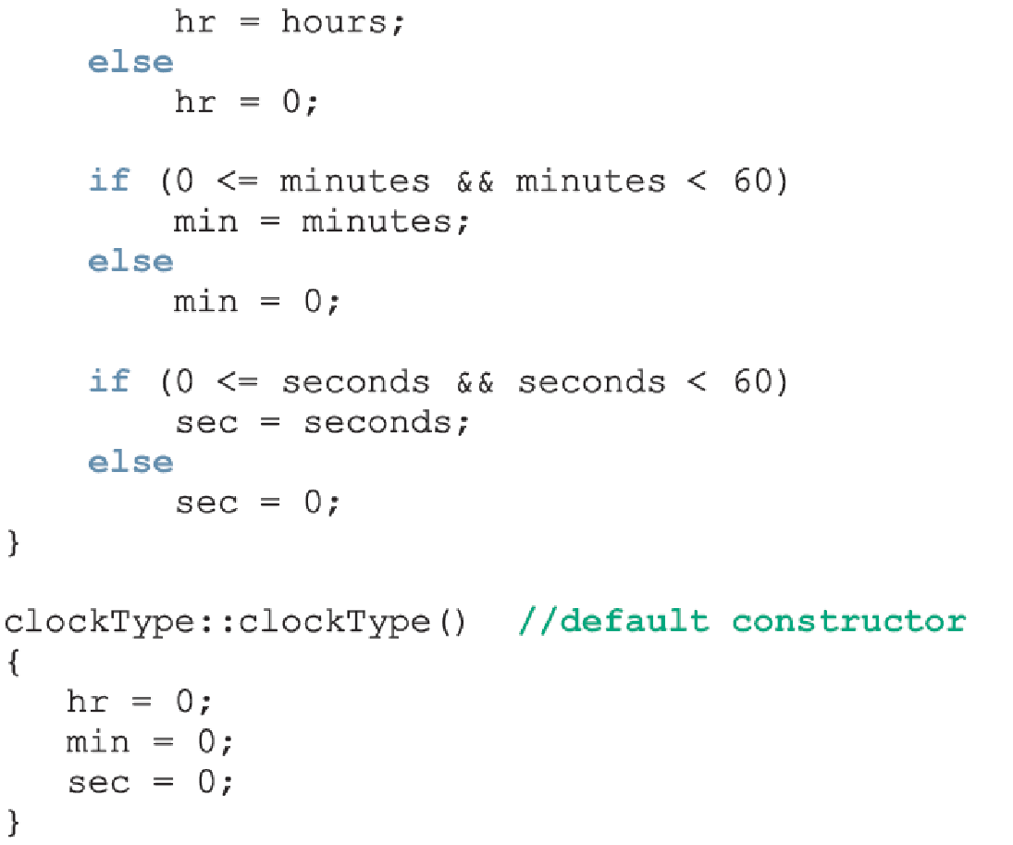
Can be replaced with:
setTime(hours, minutes, seconds);

Slide 37
Invoking a Constructor
A constructor is automatically executed when a class variable is declared
C++ Programming: From Problem Analysis to Program Design, Fourth Edition
‹#›

Slide 38

Invoking the Default Constructor
To invoke the default constructor:
Example:
clockType yourClock;
C++ Programming: From Problem Analysis to Program Design, Fourth Edition
‹#›

Slide 39
Invoking a Constructor with Parameters
Syntax:
The number of arguments and their type should match the formal parameters (in the order given) of one of the constructors
Otherwise, C++ uses type conversion and looks for the best match
Any ambiguity leads to a compile-time error
C++ Programming: From Problem Analysis to Program Design, Fourth Edition
‹#›

Slide 40
Constructors and Default Parameters
If you replace the constructors of clockType with the constructor in Line 1, you can declare clockType objects with zero, one, two, or three arguments as follows:
clockType clock1; //Line 2
clockType clock2(5); //Line 3
clockType clock3(12, 30); //Line 4
clockType clock4(7, 34, 18); //Line 5
C++ Programming: From Problem Analysis to Program Design, Fourth Edition
‹#›

Slide 41
Classes and Constructors: A Precaution
If a class has no constructor(s), C++ provides the default constructor
However, object declared is still uninitialized
If a class includes constructor(s) with parameter(s), but not the default constructor
C++ does not provide the default constructor
Note: if you have a constructor with all default parameters you cannot declare a constructor without parameters, they both called default constructor.
clockType clockType(int = 0, int = 0, int = 0);
clockType clockType (); //illegal in the same class
C++ Programming: From Problem Analysis to Program Design, Fourth Edition
‹#›

Slide 42
Examples
class A {
private:
int x;
public:
A (int =0);
};
void main()
{
A obj1();//Not Correct?!
A obj1; //Correct
}
class A {
private:
int x;
public:
A (int =0);
A();
};
void main()
{
A obj1; //illegal
}
class A {
private:
int x;
public:
A (int);
};
void main() {
A obj1; //illegal
}
class A {
private:
int x;
Int y;
public:
A (int);
A(int, int=0);
};
void main() {
A obj1(3); //illegal
}

Slide 43
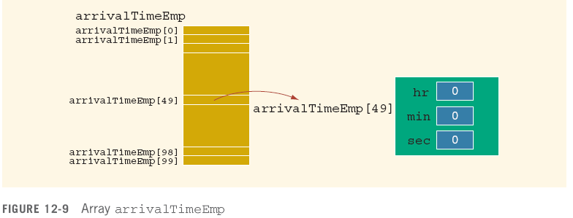
Arrays of Class Objects (Variables) and Constructors
If a class has constructors and you declare an array of that class’s objects, the class should have the default constructor
C++ Programming: From Problem Analysis to Program Design, Fourth Edition
‹#›

Slide 44
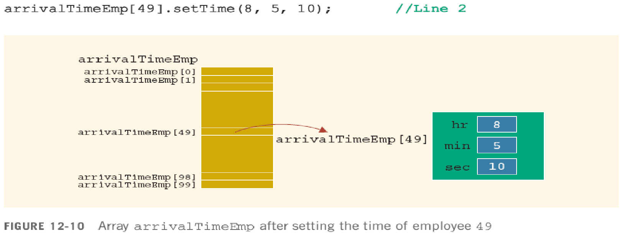
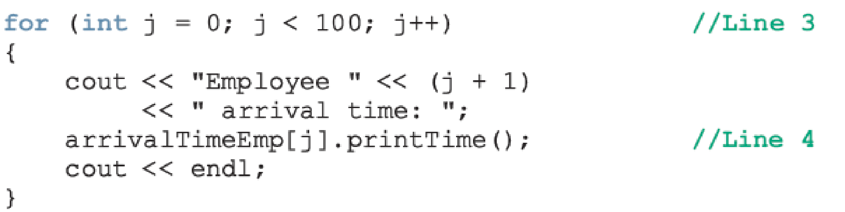
Arrays of Class Objects (Variables) and Constructors (continued)
C++ Programming: From Problem Analysis to Program Design, Fourth Edition
‹#›

Slide 45
Destructors
Destructors are functions without any type
The name of a destructor is the character '~' followed by class name
For example:
~clockType();
A class can have only one destructor
The destructor has no parameters
The destructor is automatically executed when the class object goes out of scope
C++ Programming: From Problem Analysis to Program Design, Fourth Edition
‹#›

Slide 46
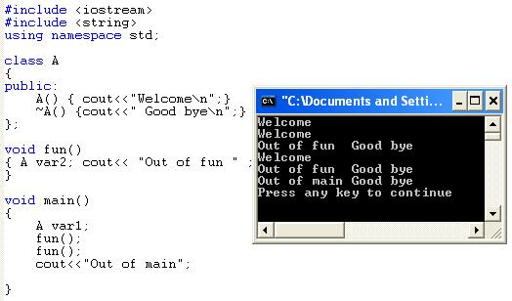
Example

Slide 47
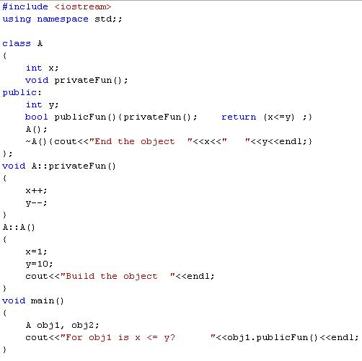
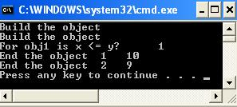
Example

Slide 48
Data Abstraction, Classes, and Abstract Data Types
Abstraction
Separating design details from usage
Separating the logical properties from the implementation details
Abstraction can also be applied to data
Abstract data type (ADT): data type that separates the logical properties from the implementation details
C++ Programming: From Problem Analysis to Program Design, Fourth Edition
‹#›

Slide 49
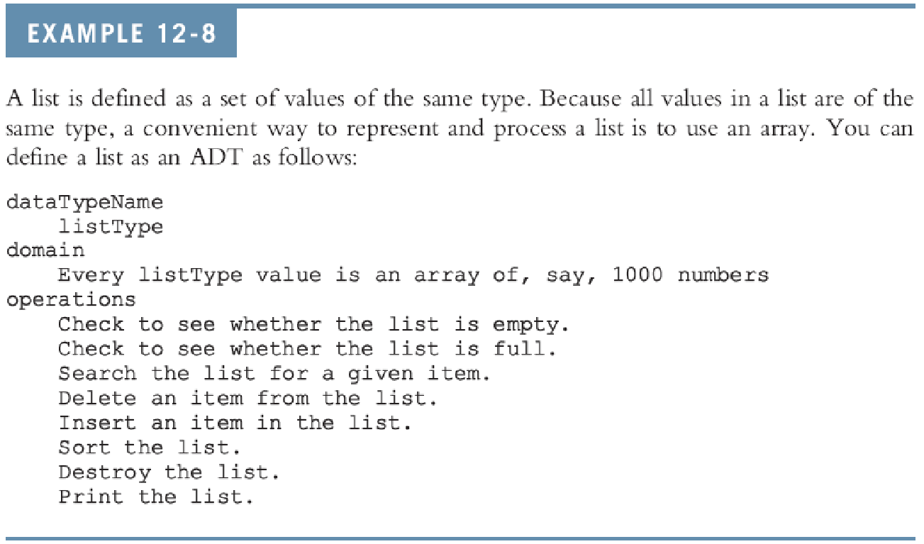
Data Abstraction, Classes, and Abstract Data Types (continued)
C++ Programming: From Problem Analysis to Program Design, Fourth Edition
‹#›

Slide 50
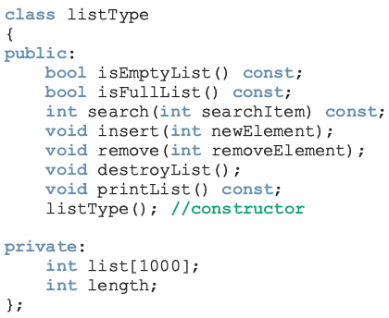
Data Abstraction, Classes, and Abstract Data Types (continued)
C++ Programming: From Problem Analysis to Program Design, Fourth Edition
‹#›

Slide 51
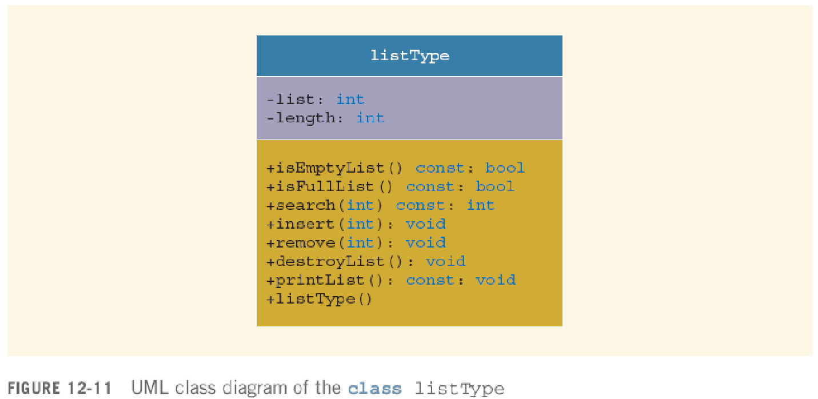
Data Abstraction, Classes, and Abstract Data Types (continued)
C++ Programming: From Problem Analysis to Program Design, Fourth Edition
‹#›

Slide 52
A struct versus a class
By default, members of a struct are public
private specifier can be used in a struct to make a member private
By default, the members of a class are private
classes and structs have the same capabilities
C++ Programming: From Problem Analysis to Program Design, Fourth Edition
‹#›

Slide 53
A struct versus a class (continued)
In C++, the definition of a struct was expanded to include member functions, constructors, and destructors
If all member variables of a class are public and there are no member functions
Use a struct
C++ Programming: From Problem Analysis to Program Design, Fourth Edition
‹#›

Slide 54
Information Hiding
Information hiding: hiding the details of the operations on the data
Interface (header) file: contains the specification details
Implementation file: contains the implementation details
In header file, include function prototypes and comments that briefly describe the functions
Specify preconditions and/or postconditions
C++ Programming: From Problem Analysis to Program Design, Fourth Edition
‹#›

Slide 55
Information Hiding (continued)
Precondition: a statement specifying the condition(s) that must be true before the function is called
Postcondition: a statement specifying what is true after the function call is completed
C++ Programming: From Problem Analysis to Program Design, Fourth Edition
‹#›

Slide 56
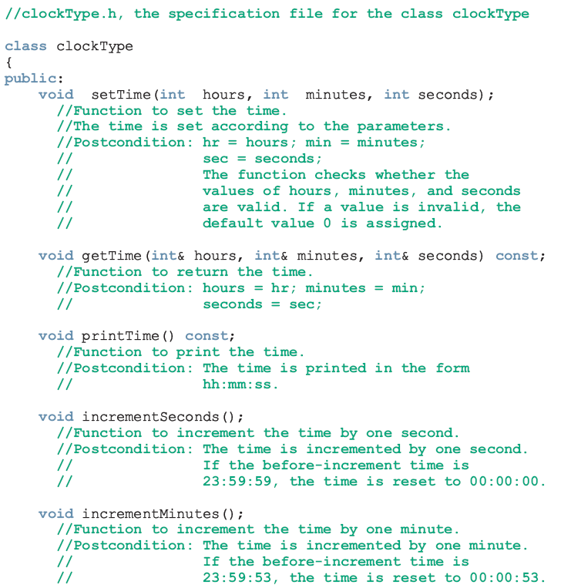

Slide 57
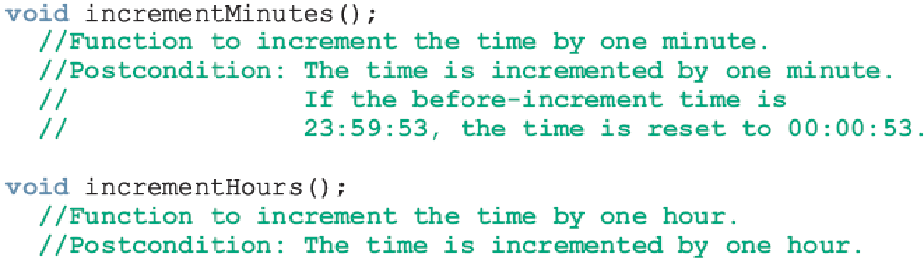
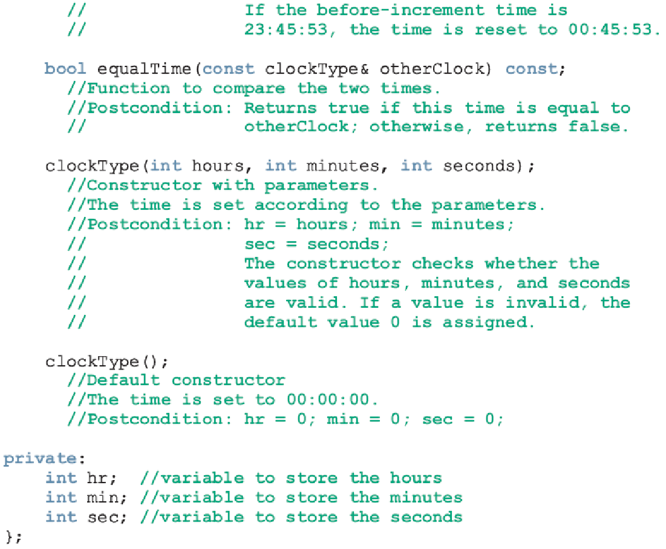

Slide 58
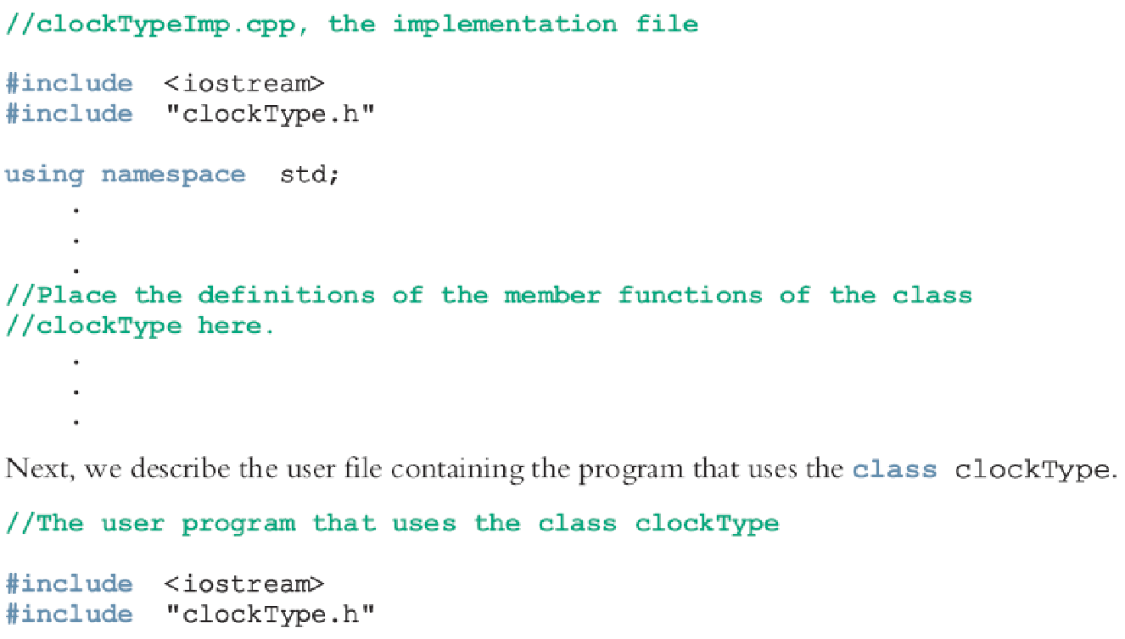
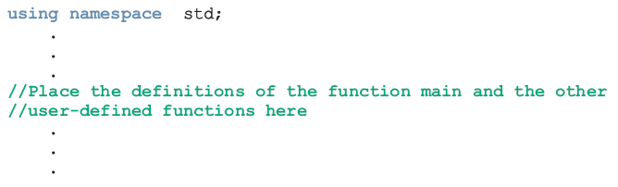

Slide 59
Information Hiding (continued)
Header file has an extension .h
Implementation file has an extension .cpp
Implementation file must include header file via include statement
In include statement:
User-defined header files are enclosed in double quotes
System-provided header files are enclosed between angular brackets
C++ Programming: From Problem Analysis to Program Design, Fourth Edition
‹#›

Slide 60
Executable Code
To use an object in a program
The program must be able to access the implementation
Visual C++, Visual Studio .NET, C++ Builder, and CodeWarrior put the editor, compiler, and linker into a package
With one command, the program is compiled and linked with the other necessary files
These systems also manage multiple file programs in the form of a project
C++ Programming: From Problem Analysis to Program Design, Fourth Edition
‹#›

Slide 61
Executable Code (continued)
A project consists of several files, called the project files
These systems usually have a command, called build, rebuild, or make
When applied to a project, system compiles and links all files required to create the executable code
When file(s) in the project change, use these commands to recompile and relink the files
C++ Programming: From Problem Analysis to Program Design, Fourth Edition
‹#›

Slide 62
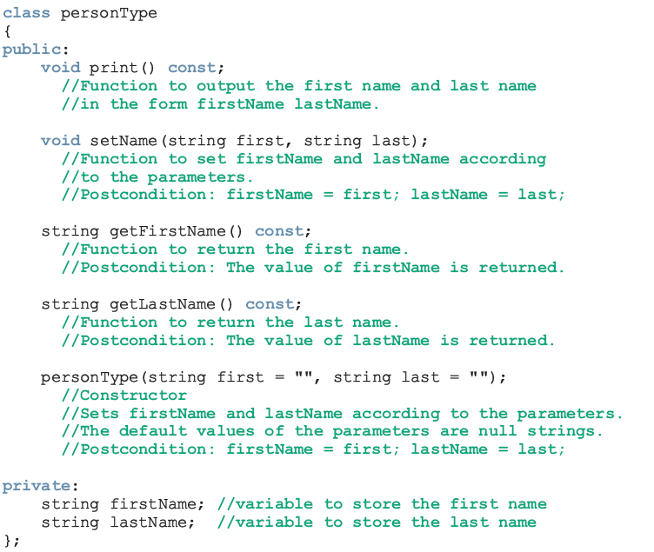

Slide 63
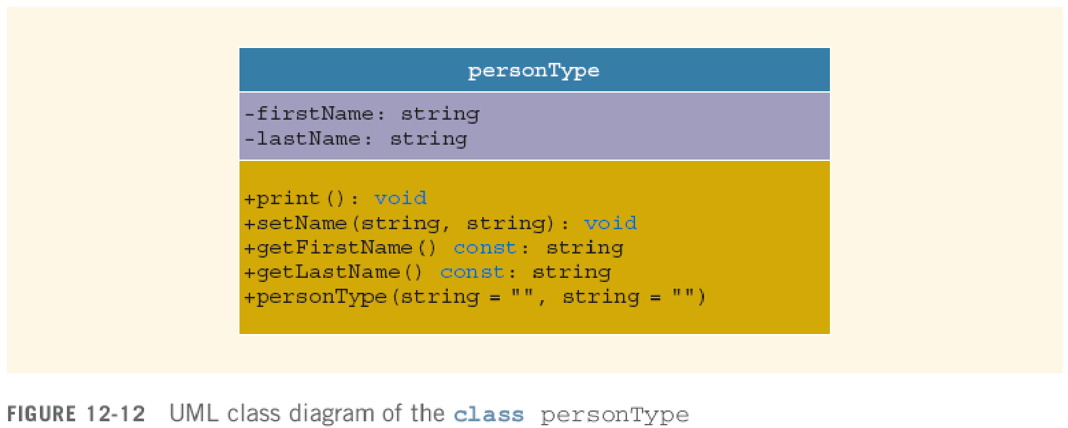
Executable Code (continued)
C++ Programming: From Problem Analysis to Program Design, Fourth Edition
‹#›

Slide 64
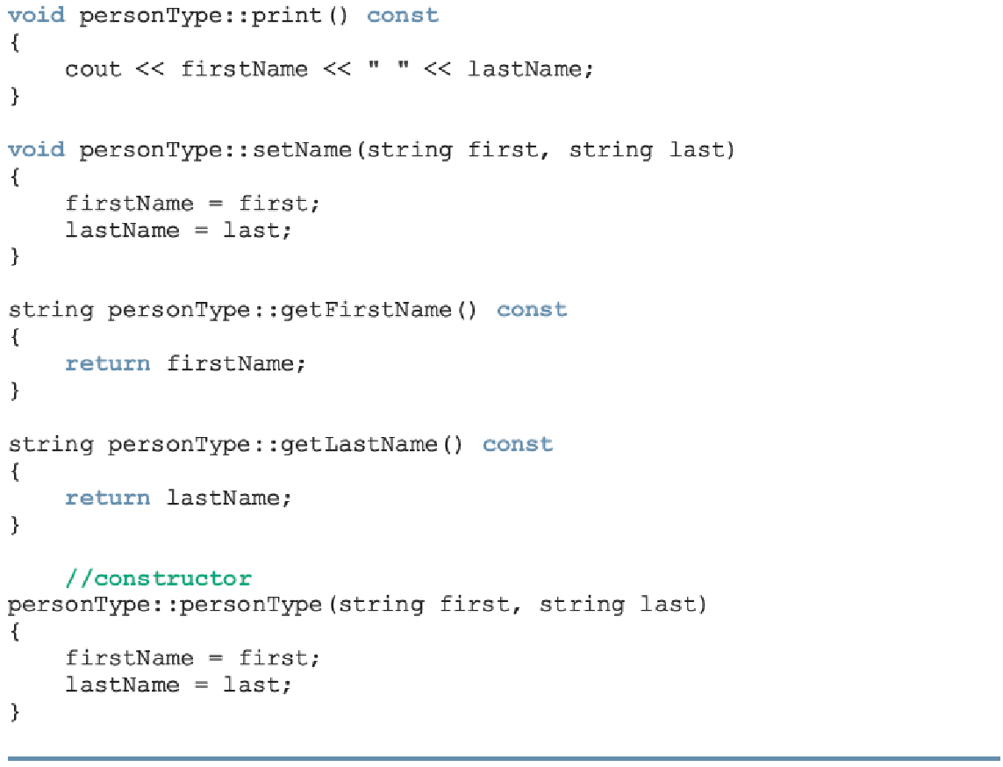

Slide 65
Static Members of a Class
Use the keyword static to declare a function or variable of a class as static
A public static function or member of a class can be accessed using the class name and the scope resolution operator
static member variables of a class exist even if no object of that class type exists
C++ Programming: From Problem Analysis to Program Design, Fourth Edition
‹#›

Slide 66
Static Members of a Class
A static member function of a class can only access a static member variable
A static member variable should be initialized out the class braces by using the class name and the scope resolution operator(::)
static const member variable should be initialized within the class
C++ Programming: From Problem Analysis to Program Design, Fourth Edition
‹#›

Slide 67
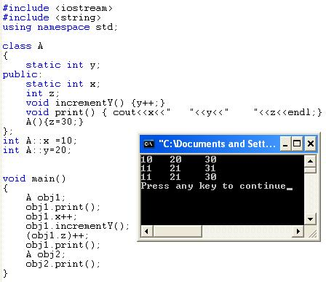
Examples

Slide 68
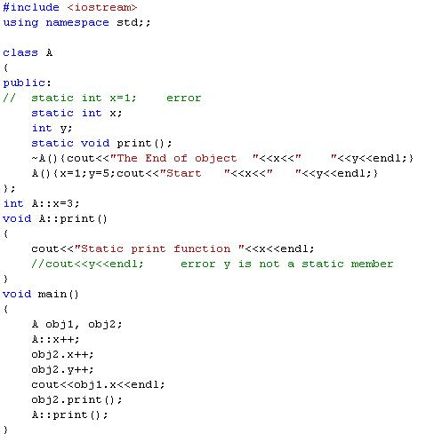
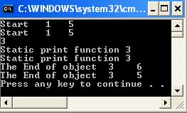

Slide 69
Summary
Class: collection of a fixed number of components
Members: components of a class
Accessed by name
Classified into one of three categories:
private, protected, and public
Class variables are called class objects or, simply, objects
C++ Programming: From Problem Analysis to Program Design, Fourth Edition
‹#›

Slide 70
Summary (continued)
The only built-in operations on classes are the assignment and member selection
Constructors guarantee that data members are initialized when an object is declared
Default constructor has no parameters
Destructors automatically execute when a class object goes out of scope
A class can have only one destructor
The destructor has no parameters
C++ Programming: From Problem Analysis to Program Design, Fourth Edition
‹#›

Slide 71
Summary (continued)
Abstract data type (ADT): data type that separates the logical properties from the implementation details
A public static member, function or data, of a class can be accessed using the class name and the scope resolution operator
Static data members of a class exist even when no object of the class type exists
Instance variables: non-static data members
C++ Programming: From Problem Analysis to Program Design, Fourth Edition
‹#›

